Slide 1
Tips to Researching on the Internet
Guide for the Researching Tips Worksheet

Slide 2

Choosing a Browser
A browser allows you to navigate the World Wide Web.
The most common browsers are:
Chrome, Firefox, Explorer, and Safari

Slide 3
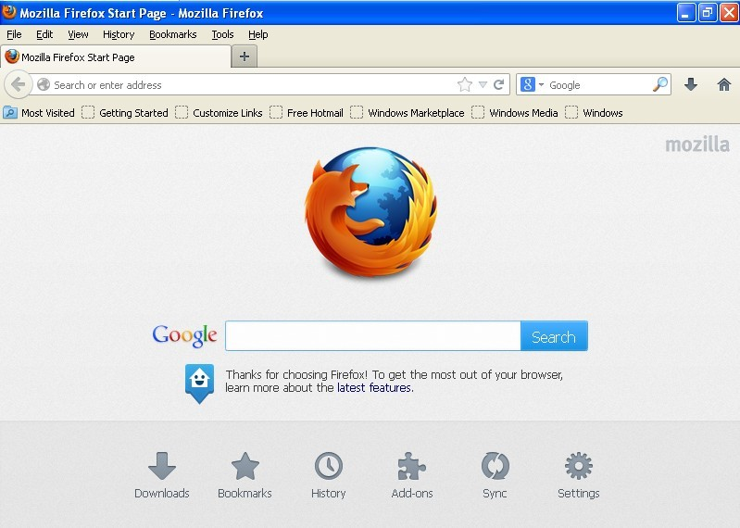
Using a Browser
Menu – Includes all options available for the program.
Search Bar – Allows you to do a random search
URL – (Uniform Resource Identifier)
Used for specific web addresses.
Bookmark Bar – Mark the pages you will visit often
Browser Window – Allows you to view sites

Slide 4

Choosing a Search Engine
Search Engines help you find information and items in databases by using keywords.
Basically you would use one that you feel the most comfortable using.
Google is the most used today with over 40 billion pages and over 300 million searches every day.

Slide 5
Searching Tips:
1. Use specific terms:
Keep your search simple, use as few words as possible. If your search is not what you are looking for, then add more descriptive words until you find what you are looking for.

Slide 6
Searching Tips:
2. Choose your words carefully
Choose words that are likely to appear on the site. Instead of searching “my head hurts”, search “headache”.

Slide 7
Searching Tips:
3. Don’t worry about the little things
Don’t stress about spelling, the search will pick up the most common words to fit your search.
Also, search engines don’t distinguish between capitals from lowercase. So don’t capitalize words.

Slide 8
Searching Tips:
4. Don’t use common words or punctuation:
Words like the and a are called stop words and are usually ignored in a search, the same with punctuation. However if a common word is important to your search, then use it, such as The Giver.

Slide 9
Searching Tips:
5. Use quotations for exact phrases.
using quotation marks around a phrase will return only those exact words in that order.
Notes:
Use

Slide 10
Searching Tips:
6. Use the minus operator ( - ) to narrow your search.
words with several meanings could return too many unwanted results. For example when you search for bears you get results for Chicago Bears, so put search in as bears –chicago, and Chicago Bears will not appear in the results.

Slide 11
Searching Tips:
7. Find Quick Answers
Type in the topic you request and then the city or zipcode, then the answer will display. Examples:
  weather:salt lake city
  movie:84651
A search engine can also be used as a dictionary or calculator. Examples:
  define:search engine
  calculate: 5 * 845

Slide 12
Resources:
https://support.google.com/websearch/answer/134479?hl=en
http://www.techrepublic.com/blog/10-things/10-tips-for-smarter-more-efficient-internet-searching/

