Slide 1
Many ways to communicate Electronically
Advantages vs Disadvantages

Slide 2
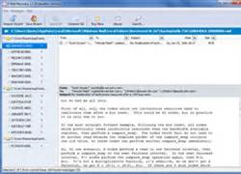
E-mail
Advantages
Easy to use
Fast
Do not use paper
Can communicate with anyone in the world
Disadvantages
Can carry viruses
SPAM – unwanted solicitations
Not private

Slide 3
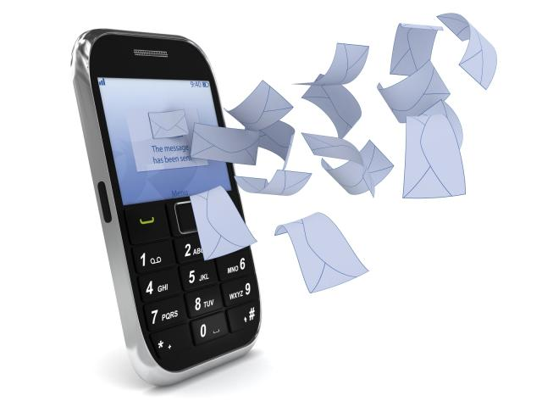
SMS – Short Message Service Text Messages
Advantages
Send quick message easily
Texting is great solution when cannot talk out loud
Fairly inexpensive if unlimited texting is on contract
Disadvantages
Slow texters
Sometimes the text is delayed in arriving
Limited to 160 characters per message

Slide 4
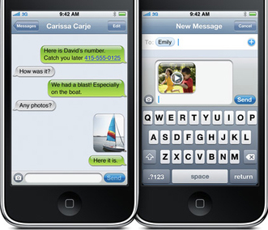
MMS - Multimedia Messaging Service
A system that enables cell phones to send and receive pictures , sound clips, and text messages
Advantages
Can send more than just text
No character limit
Disadvantages
Costs more
Sometimes quality is an issue

Slide 5
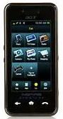
Smart phone
Disadvantages
Expensive
Reception can be poor
Distraction to drivers
Easily lost/damaged/stolen
Advantages
Always carry so no missed calls
Good for emergencies
Take pictures of accident
Text, play games, listen to music
Surf Internet
Fits in pocket

Slide 6
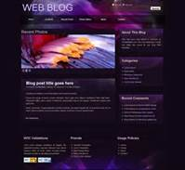
blog
Disadvantages
Takes time to keep updated
Not confidential at public forum
No immediate resolution to problems
Once posted, cannot take it back
Advantages
Convenient
Easy to use and access
Great place for collaborating

Slide 7
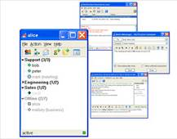
IM - Instant message
Advantages
Real Time
Fast
Can receive immediate feedback
Disadvantages
No face-to-face
Can’t see emotions
Cannot be sure with whom you are talking
Security risks

Slide 8
Internet
Disadvantages
Theft of personal information
Malware/ viruses
Inappropriate content
Social isolation
Obesity
Depression
Advantages
Abundant information
Education at fingertips
Entertainment
Social networking
Online services (e-commerce)

Slide 9
Voip - Voice Over Internet Protocol
Telephonic communication via the Internet
Examples:
Skype
LINE
Advantages
Real Time
Use webcams and can see & hear loved ones around the world
Free or low costs
Disadvantages
Both parties must use the same service or it’s not free
No service during power outage
911 calls cannot be traced to site of the emergency
Security – identity & service theft, virus & malware

Slide 10
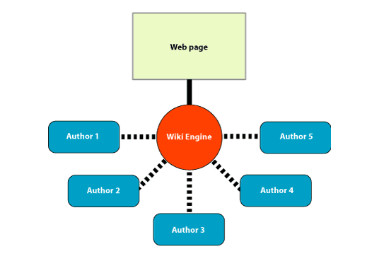
Wiki
Looks like a webpage except users can read, write, edit and collaborate with others
Wikipedia is a good example.
The wiki software is called WYSIWIG - or What You See Is What You Get
Advantages
Easy to use
Uses wiki software not HTML coding
Anyone can publish
Great collaboration tool
Non-techie people can publish to the web
Disadvantages
Anyone can edit – yet access can be regulated
Information can become disorganized or incorrect

Slide 11
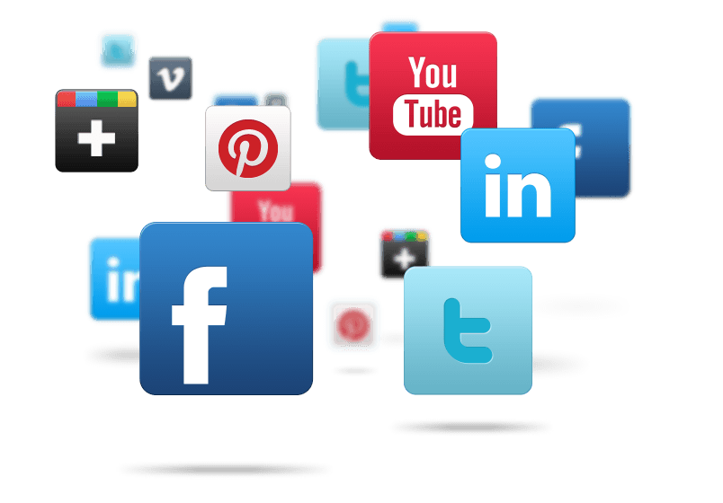
Social Media
Websites and apps used for social networking
Examples
Facebook
Twitter
LinkedIn
Advantages
Easy to stay in touch with loved ones
Global communication
Can attract attention to your site, product, or services
Improves users’ technological skills
Disadvantages
Distraction – might spend too much time here
Negative comments could go viral

Slide 12
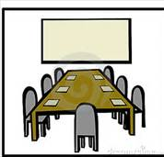
Teleconference Connects people in real time through audio and video using laptop, smartphones, or tablets
Advantages
Significant travel savings
Improved communication
Group collaboration increases productivity
Disadvantages
Good quality is not free
Not always user friendly

Slide 13
Sources
https://docs.google.com/ research

